Slide 1
Exploratory Data Analysis – IPL Performance
Term -1 Project
Abhinav Marwah

Slide 2

Problem Statement
To perform exploratory data analysis for collective data set of IPL performance for 2008 – 2018
The raw data needs to be structured to perform the accurate data analysis

Slide 3
Data Profiling
It has been identified that there are total 696 entries in the data. In addition, "city" field has 7 values missing, "winner" field has 3 values missing, "player of the match" has 3 values missing and "umpire 1" & "umpire 2" has 1 each missing value
Replacing “City” and “Winner” field in data set to match the total count of rows for performance accuracy

Slide 4
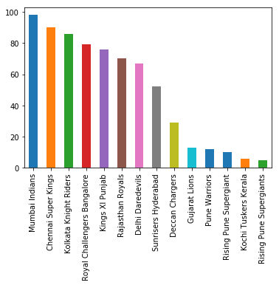
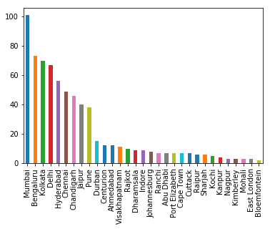
Data Analysis
Winner | bat | field | All
Chennai Super Kings | 50 | 40 | 90
Deccan Chargers | 14 | 15 | 29
Delhi Daredevils | 29 | 38 | 67
Gujarat Lions | 2 | 11 | 13
Kings XI Punjab | 21 | 55 | 76
Kochi Tuskers Kerala | 0 | 6 | 6
Kolkata Knight Riders | 35 | 51 | 86
Mumbai Indians | 42 | 59 | 101
Pune Warriors | 9 | 3 | 12
Rajasthan Royals | 34 | 36 | 70
Rising Pune Supergiants | 2 | 13 | 15
Royal Challengers Bangalore | 26 | 53 | 79
Sunrisers Hyderabad | 19 | 33 | 52
All | 283 | 413 | 696
Team with Maximum Win
Winner against Bat vs. Field
Maximum matches played in the city
Mumbai Indians has the maximum number of wins = 98 in the overall series across years
Kochi Tuskers has win all the 6 matches during chase followed by Rising Pune Supergiant with 87% win against chase Pune Warriors have maximum win i.e. 75% against Bat followed by Chennai Super Kings with 56%
Mumbai has the maximum number of matches played = 101 in the overall series across years

Slide 5
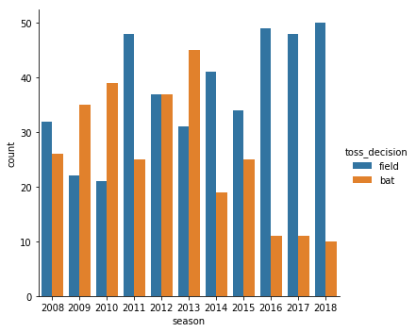
Data Analysis – contd.
Toss Winner | Total Toss Win
Chennai Super Kings | 77
Deccan Chargers | 43
Delhi Daredevils | 80
Gujarat Lions | 15
Kings XI Punjab | 75
Kochi Tuskers Kerala | 8
Kolkata Knight Riders | 87
Mumbai Indians | 90
Pune Warriors | 20
Rajasthan Royals | 69
Rising Pune Supergiant | 6
Rising Pune Supergiants | 7
Royal Challengers Bangalore | 77
Sunrisers Hyderabad | 42
Toss_winner | Total Match Win against Toss
Chennai Super Kings | 50
Deccan Chargers | 19
Delhi Daredevils | 35
Gujarat Lions | 10
Kings XI Punjab | 32
Kochi Tuskers Kerala | 4
Kolkata Knight Riders | 49
Mumbai Indians | 50
Pune Warriors | 3
Rajasthan Royals | 37
Rising Pune Supergiant | 0
Rising Pune Supergiants | 3
Royal Challengers Bangalore | 39
Sunrisers Hyderabad | 21
% Win against Toss_Win
Bat vs. Field Performance
Rising Pune Supergiant have the maximum win i.e. 83% if they won the toss followed by Gujrat Lions with 67% Only 15% wins against toss win is factored for Pune Warriors
Field has seemingly shown an increase in performance over succeeding seasons. Players are becoming more consistent in terms of chasing the target against the opponent

Slide 6
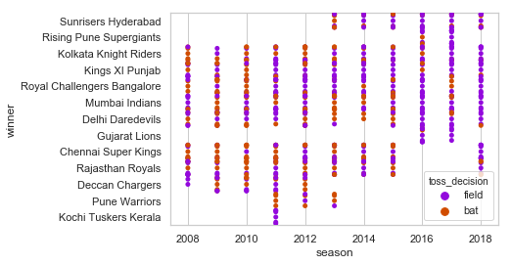
Data Analysis – contd.
Bat vs. Field Performance
2010 predicts that the Target setter outreached the Target chaser
As with the succeeding years, Field performance has seen tremendous change vs. Batting

Slide 7
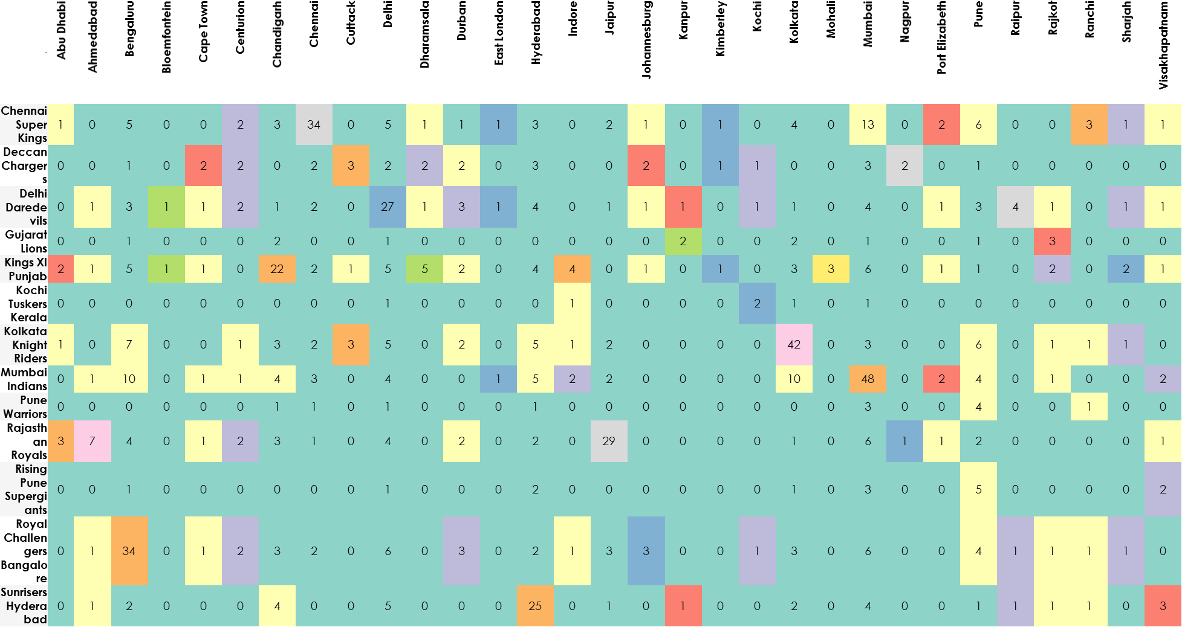
Data Analysis – contd.
Home ground Performance
More than 50% of the win for majority of the team have achieved at their homeground

Slide 8
Thank You

